Slide 1

SR UNIVERSITY

Slide 2
LIBRARY MANAGEMENT SYSTEM
SUBMITTED BY:
SUBMITTED TO:
2103A51069 - S.REVANTH
2103A51182 - P.SAI TEJA
2103A51569 - N.SANDEEP
MADHIRA SRINIVAS
Assistant Professor

Slide 3
Introduction A library management project that manages and stores book information. The system helps students to keep a constant track of all the books available in the library.

Slide 4
context
Abstract
Modules of our Project
Code of our Project
Outputs of our Project
Conclusion

Slide 5
abstract
Our project is ‘library management system’.
A library management project that manages and stores book information.
The record of the issued book with user details can also be viewed.

Slide 6
Modules of our project
1.Issuing of book
For our project the first module is ISSUING OF BOOK. To Issue the book, first a menu option is given whether you want to issue a book, return a book or display student details.
To issue you have to enter the ‘1’ option. Then it will ask you which book you want. Each book has unique identification number. We need to enter the book id to get thet book. Then the issued book details is going to display.

Slide 7
2dff222
2.Returning the book
For our project the second module is returning the book. To return the book you have to enter the ‘2’ option but before returning any book, first the book should be issued. If not it will give a message that book doesn’t exist. So after pressing the option ‘2’ for submission of book then it will ask to enter the book I’d number So that according to the I’d number the book is going to returned. Then once the book is returned then it gives a message that the book submission successfull.

Slide 8
3.Displaying student details
For our project the third module is displaying student details. To display the student details you have to enter the ‘3’ option but before displaying check whether you have issued the books or not. If not it gives a message that no bookings are found. So when you click the option ‘3’ then all the issued books are going to display with student name, book name, and book id.
4.Exit
For our project the fourth module is to exit from the program. To exit from the program you have to enter the ‘4’ option.

Slide 9
Code
void greetings() { printf("\t\t\t * ---------------------------- *\n"); printf("\t\t\t * WELCOME TO STUDENT LIBRARY *\n"); printf("\t\t\t * ------------------------ *\n"); printf("\t\t\t * STUDENT LIBRARY *\n"); printf("\t\t\t * ------------------------ *\n"); printf("\t\t\t * WARANGAL,TELANGANA,INDIA *\n"); printf("\t\t\t * Email: studentlib@gmail.com *\n"); printf("\t\t\t * Contact:8800991099 *\n"); printf("\t\t\t ****************************************\n"); printf("\n\n\t\t\t Press any key to continue: "); getch(); }

Slide 10
void main_menu(){ int choice; do{ printf("\n\n"); printf("\n\t\t\t*************************************************\n"); printf("\n\t\t\t\t MAIN MENU: "); printf("\n\t\t\t\t 1.ISSUE OF BOOKS "); printf("\n\t\t\t\t 2.RETURN OF BOOKS "); printf("\n\t\t\t\t 3.DISPLAY STUDENT DETAILS "); printf("\n\t\t\t\t 4.EXIT\n "); printf("\n\t\t\t*************************************************\n"); printf("\n\t\t\t\t Enter your choice: "); scanf("%d",&choice);
Menu option code

Slide 11
struct student *book_issue(struct student *start){ struct book *ptr; struct student *ptr2,*new_student; int i=1,id,flag=0; if(start_lib==NULL){ printf("\n\t\t\t\t No books left in the library to issue!\n\t\t\t\t Sorry for the inconvenience!\n"); }else{ system("cls"); ptr=start_lib; printf("\n\t*************** Books Available: ****************\n"); while(ptr!=NULL){ printf("\n\t_________________________________________________\n"); printf("\n\t Book %d",i); printf("\n\t Book Title: %s",ptr->name); printf("\n\t Name of Author: %s",ptr->author); printf("\n\t Book ID: %d",ptr->id); printf("\n\t_________________________________________________\n"); ptr=ptr->next; i++; }
Function code of book issue

Slide 12
printf("\n\n\t Enter the Book ID: "); scanf("%d",&id); ptr=start_lib; while(ptr!=NULL){ if(ptr->id==id){ flag=1; break; } ptr=ptr->next; } if(flag==1){ ptr=start_lib; while(ptr->id!=id){ ptr=ptr->next; } new_student=(struct student *)malloc(sizeof(struct student)); printf("\n\t Enter Student Details:\n "); printf("\n\t Enter your Name: "); scanf("%s",new_student->name); printf("\n\t Enter your Email: "); scanf("%s",new_student->email); strcpy(new_student->book,ptr->name); strcpy(new_student->a,ptr->author); new_student->id=ptr->id; new_student->next=NULL; printf("\n\t Issue of Book ID %d done successfully!\n",new_student->id);

Slide 13
struct student *book_return(struct student *start){ struct student *ptr,*preptr; char bookname[30],authorname[30]; int flag=0,id,identity,c=0,d=1; printf("\n\n\t*************** Books Submission: ****************\n"); printf("\n\n\t Enter your Book ID: "); scanf("%d",&identity); ptr=start; while(ptr!=NULL){ if(ptr->id==identity){ flag=1; break; } ptr=ptr->next; } if(flag==1){ ptr=start; while(ptr!=NULL){ c++; ptr=ptr->next; }
Function Code for returning book

Slide 14
ptr=start; while(ptr->id!=identity){ d++; ptr=ptr->next; } ptr=start; if( d==1 ){ printf("\n\t_________________________________________________\n"); printf("\n\t Student Name: %s",start->name); printf("\n\t Student Email: %s",start->email); printf("\n\t Name of Book Issued: %s",start->book); printf("\n\t_________________________________________________\n"); printf("\n\n\t Return of Book ID %d done successfully!\n",identity); printf("\n\n\t*************************************************\n"); strcpy(bookname,start->book); strcpy(authorname,start->a); id=start->id; start=start->next; free(ptr); add_book(bookname,authorname,id); }

Slide 15
void display(struct student *start){ struct student *ptr; ptr=start; while(ptr!=NULL){ printf("\n\t************* Details of Students: **************\n"); printf("\n\t_________________________________________________\n"); printf("\n\t\t Student Name: %s",ptr->name); printf("\n\t\t Student Email: %s",ptr->email); printf("\n\t\t Name of Book Issued: %s",ptr->book); printf("\n\t\t Book ID: %d",ptr->id); printf("\n\t_________________________________________________\n"); printf("\n\n\t*************************************************\n"); ptr=ptr->next; } printf("\n\n\t Press any key to go to the main menu: "); getch(); system("cls"); }
Function Code for displaying student details

Slide 16
Outputs of our code

Slide 17
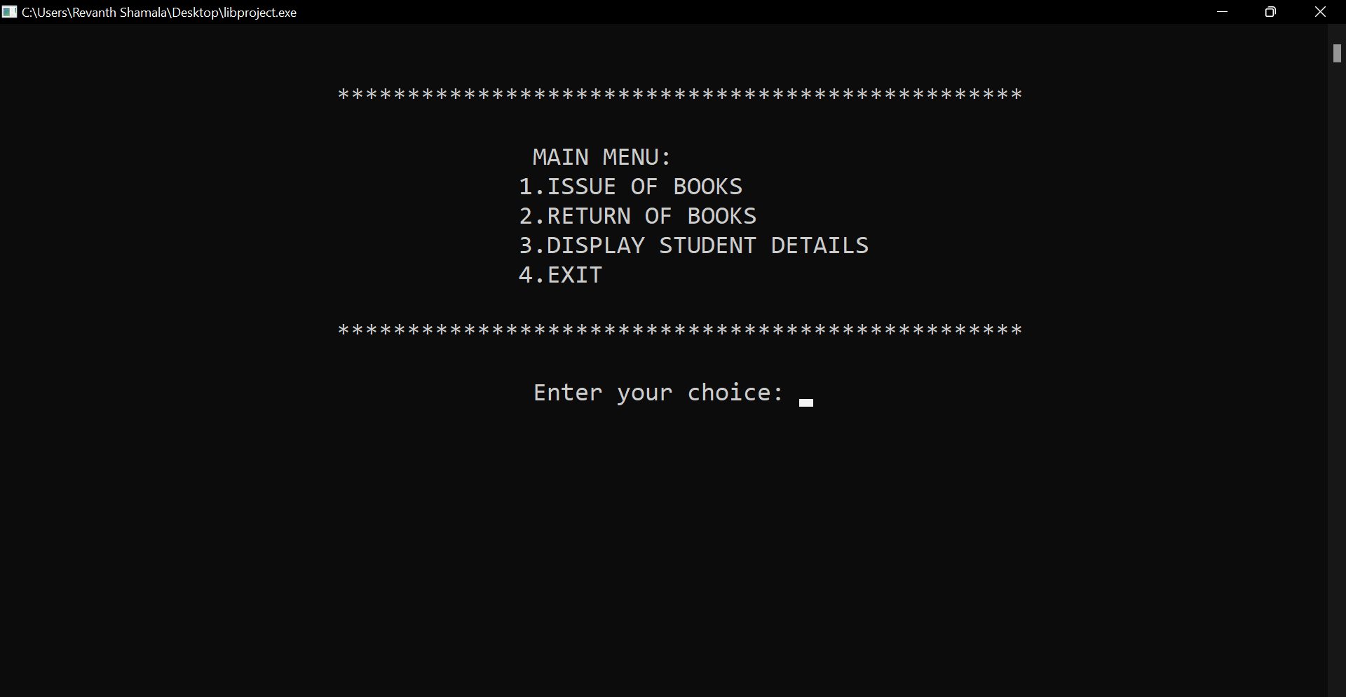
MAIN MENU:

Slide 18
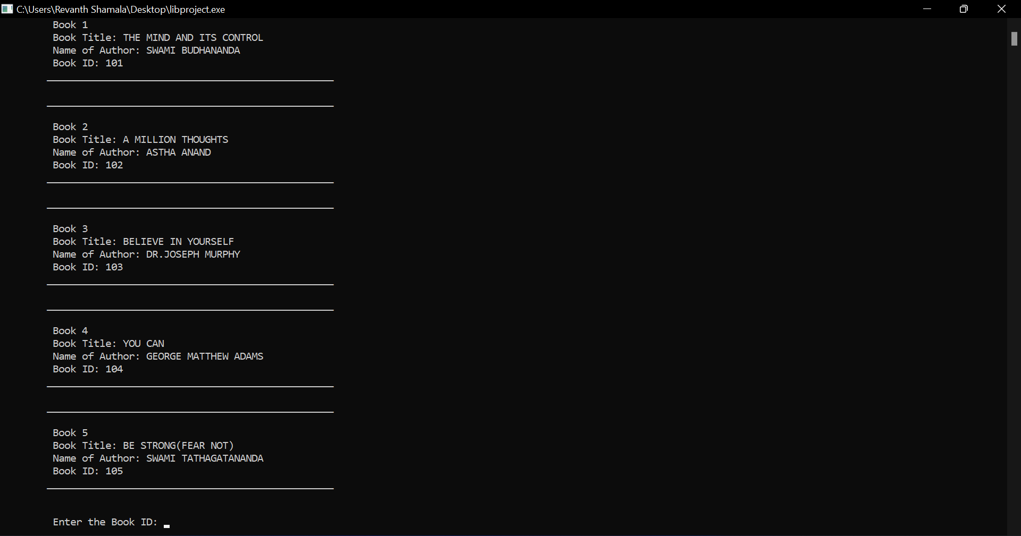
BOOKS LIST:

Slide 19
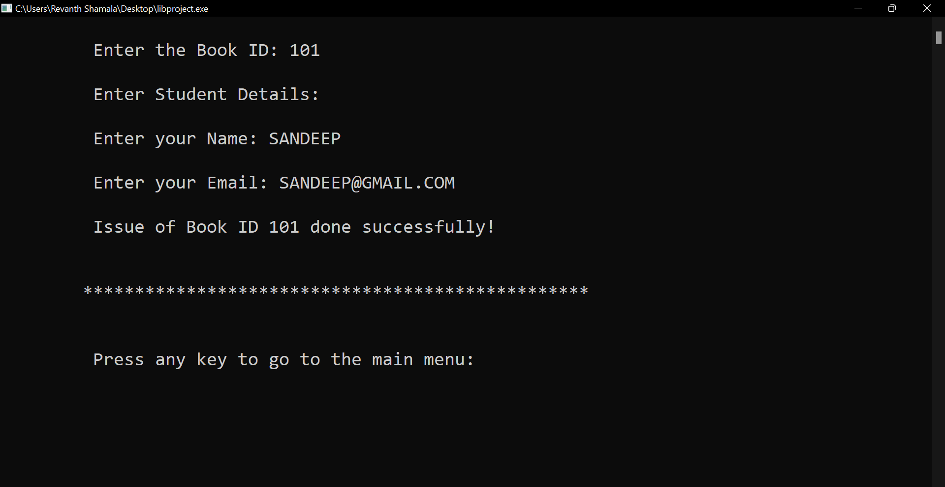
ISSUING of BOOKS:

Slide 20
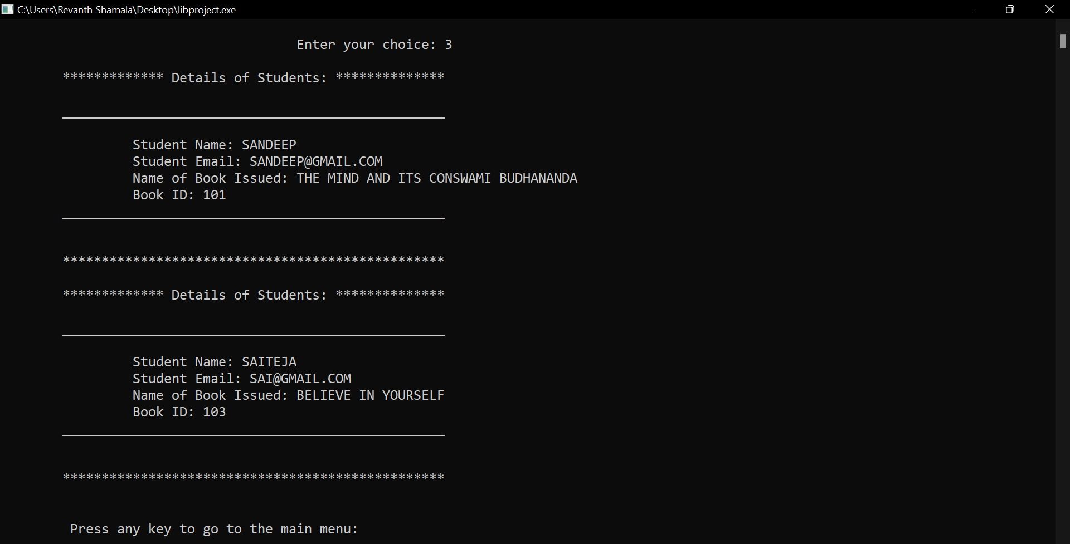
DISPLAYING STUDENT DETAILS:

Slide 21
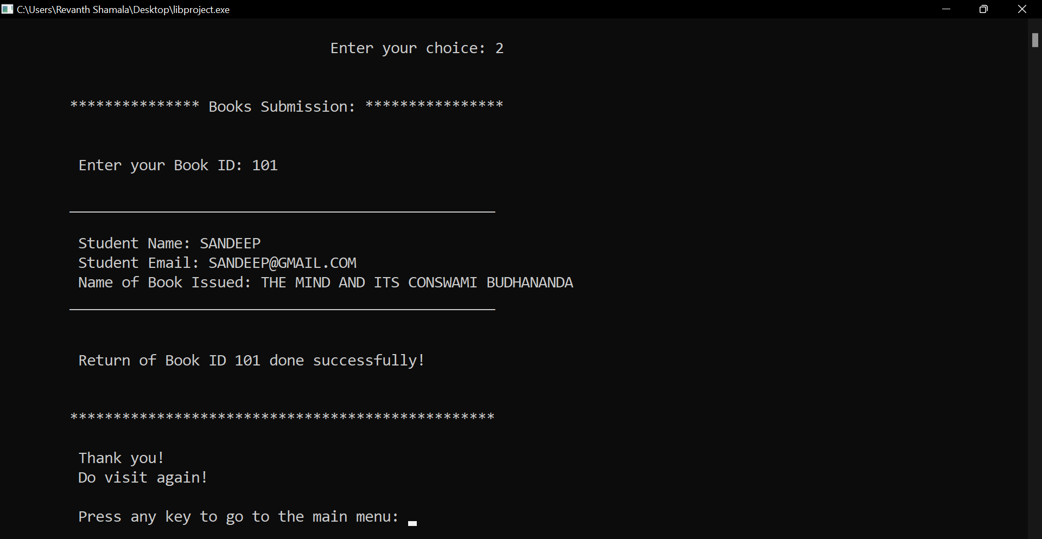
Books submission:

Slide 22
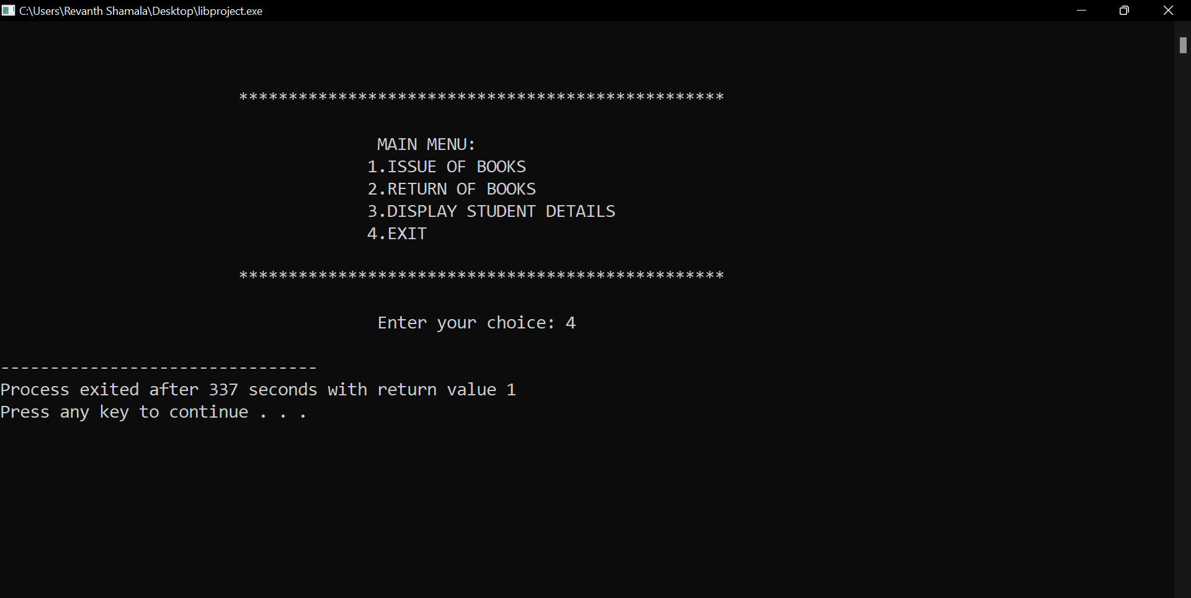
EXIT:

Slide 23
CONCLUSION:
It reduces the scope of manual errors and conveniently maintains record of books.
It has the record of the issued book with user details which makes work easier to library manager.

Slide 24

Notes:
Ckhbsakchbscmbsc

